Slide 1
Employee Data Analysis using Excel
STUDENT NAME: NAVIENA SHRI G L (asunm1353312209320)
REGISTER NO: 312209320
DEPARTMENT: B.COM GENERAL
COLLEGE: ANNA ADARSH COLLEGE FOR WOMEN

Slide 2
PROJECT TITLE
Employee Performance Analysis using Excel

Slide 3


AGENDA
Problem Statement
Project Overview
End Users
Our Solution and Proposition
Dataset Description
Modelling Approach
Results and Discussion
Conclusion
3/21/2024 Annual Review

Slide 4

PROBLEM STATEMENT
Employee performance analysis is essential for identifying strengths and areas for improvement, ensuring that each team member is contributing effectively to the organization's goals. It helps in making informed decisions about promotions, training needs, and resource allocation. Additionally, regular performance evaluations foster a culture of accountability and motivation, ultimately leading to increased productivity and employee engagement.

Slide 5

PROJECT OVERVIEW
Employee performance analysis is essential for identifying strengths and areas for improvement, ensuring that each team member is contributing effectively to the organization's goals. It helps in making informed decisions about promotions, training needs, and resource allocation. Additionally, regular performance evaluations foster a culture of accountability and motivation, ultimately leading to increased productivity and employee engagement.

Slide 6


WHO ARE THE END USERS?
Organization/Company
Management/Leadership
Human Resources (HR)
Team Leads/Supervisors
Employees

Slide 7

OUR SOLUTION AND ITS VALUE PROPOSITION
Conditional formatting – To identify the missing data
Filter – To sort and find the missing data
Formula – To find the performance level
Pivot table – To summarize the data
Chart – To visualize the given data

Slide 8
Dataset Description
Employee dataset – Kaggle
Total – 26 Features
Used features – 13
Employee ID
First name
Last name
Exit date
Business unit
Employee Status
Employee type
Employee classification type
Department type
Gender code
Performance score
Current employee rating
Performance level

Slide 9

THE "WOW" IN OUR SOLUTION
FORMULA :
“IFS(Z2>=5,"VERY HIGH", 22>=4, "HIGH",22>=3,"MEDIUM", "TRUE", "LOW")”
This formula is used to find the performance level of the employees which is derived as "medium, low and high". And this performance level is used to get an graphical representation of the employees performance.
CONDITIONAL FORMATTING : The conditional formatting is used to identify the missing data in a cell, highlight the missing cells and also to remove the missing cell.
3/21/2024 Annual Review
9

Slide 10
MODELLING
1. Data Screening:
The dataset was screened to ensure it included all relevant variables like employee ID, business units, and performance scores, ensuring completeness for analysis.
2. Data Cleaning:
Data cleaning addressed inconsistencies by removing duplicates, correcting errors, and handling missing values, ensuring accurate and reliable data for analysis.
3. Data Formulating:
The data was then structured by categorizing employees into performance levels: LOW, MEDIUM, HIGH, and VERY HIGH, enabling clear comparisons across different segments.
10

Slide 11
4. Pivot Table Creation:
Pivot tables were created to summarize performance across departments and business units, providing a clear overview of trends and patterns in employee performance.
5. Graphical Representations:
Bar charts and pie charts were used to visually represent performance data, making it easier to identify areas of strength and opportunities for improvement.

Slide 12
RESULTS
12

Slide 13
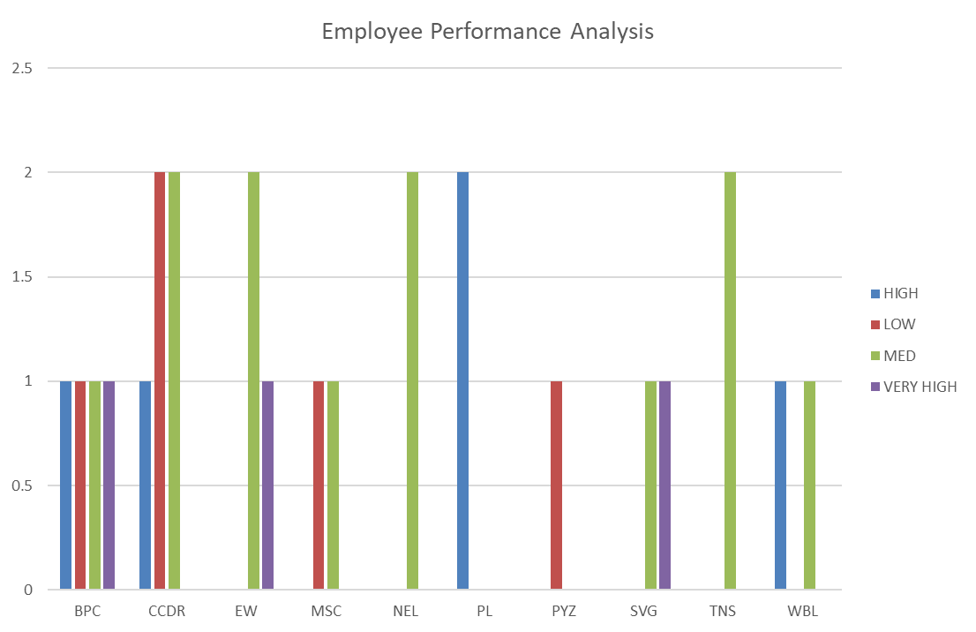

Slide 14
conclusion
The analysis highlights varying performance levels across different business units and employee classifications. A significant finding is that performance tends to vary by department and employment type, with some units showing higher concentrations of high performers. This analysis can inform management decisions on targeted training, employee development programs, and resource allocation to enhance overall productivity and employee engagement across the organization.

